Slide 1
Chapter 2. Machine Instructions and Programs

Slide 2
Memory Locations, Addresses, and Operations

Slide 3
Memory Location, Addresses, and Operation
n
bits
Memory consists of many millions of storage cells, each of which can store 1 bit.
Data is usually accessed in n-bit groups. n is called word length.
first word
second word
•
•
•
i
th word
•
•
•
last word
Figure 2.5. Memory words.

Slide 4
Memory Location, Addresses, and Operation
32-bit word length example
32 bits
•
•
•
b
31
b
30
b
1
b
0
Sign bit:
b
31
=
0
for positive numbers
b
31
=
1
for negative numbers
(a) A signed integer
8 bits
8 bits
8 bits
8 bits
ASCII
ASCII
ASCII
ASCII
character
character
character
character
(b) Four characters

Slide 5
Memory Location, Addresses, and Operation
To retrieve information from memory, either for one word or one byte (8-bit), addresses for each location are needed.
A k-bit address memory has 2^{k} memory locations, namely 0 – 2^{k}-1, called memory space.
24-bit memory: 2²⁴ = 16,777,216 = 16M (1M=2²⁰)
32-bit memory: 2³² = 4G (1G=2³⁰)
1K(kilo)=2¹⁰
1T(tera)=2⁴⁰

Slide 6
Memory Location, Addresses, and Operation
It is impractical to assign distinct addresses to individual bit locations in the memory.
The most practical assignment is to have successive addresses refer to successive byte locations in the memory – byte-addressable memory.
Byte locations have addresses 0, 1, 2, … If word length is 32 bits, they successive words are located at addresses 0, 4, 8,…

Slide 7
Big-Endian and Little-Endian Assignments
Big-Endian: lower byte addresses are used for the most significant bytes of the word
Little-Endian: opposite ordering. lower byte addresses are used for the less significant bytes of the word
W
ord
address
Byte address
Byte address
0
0
1
2
3
0
3
2
1
0
4
4
5
6
7
4
7
6
5
4
•
•
•
•
•
•
2
k
-
4
2
k
-
4
2
k
-
3
2
k
-
2
2
k
-
1
2
k
-
4
2
k
-
1
2
k
-
2
2
k
-
3
2
k
-
4
(a) Big-endian assignment
(b) Little-endian assignment
Figure 2.7. Byte and word addressing.

Slide 8
Memory Location, Addresses, and Operation
Address ordering of bytes
Word alignment
  Words are said to be aligned in memory if they begin at a byte addr. that is a multiple of the num of bytes in a word.
    16-bit word: word addresses: 0, 2, 4,….
    32-bit word: word addresses: 0, 4, 8,….
    64-bit word: word addresses: 0, 8,16,….
Access numbers, characters, and character strings

Slide 9
Memory Operation
Load (or Read or Fetch)
Copy the content. The memory content doesn’t change.
Address – Load
Registers can be used
Store (or Write)
Overwrite the content in memory
Address and Data – Store
Registers can be used

Slide 10
Instruction and Instruction Sequencing

Slide 11
“Must-Perform” Operations
Data transfers between the memory and the processor registers
Arithmetic and logic operations on data
Program sequencing and control
I/O transfers

Slide 12
Register Transfer Notation
Identify a location by a symbolic name standing for its hardware binary address (LOC, R0,…)
Contents of a location are denoted by placing square brackets around the name of the location (R1←[LOC], R3 ←[R1]+[R2])
Register Transfer Notation (RTN)

Slide 13
Assembly Language Notation
Represent machine instructions and programs.
Move LOC, R1 = R1←[LOC]
Add R1, R2, R3 = R3 ←[R1]+[R2]

Slide 14
CPU Organization
Single Accumulator
  Result usually goes to the Accumulator
  Accumulator has to be saved to memory quite often
General Register
  Registers hold operands thus reduce memory traffic
  Register bookkeeping
Stack
  Operands and result are always in the stack

Slide 15
Instruction Formats
Three-Address Instructions
  ADD R2, R3, R1 R1 ← [R2] + [R3]
Two-Address Instructions
  ADD R1, R2 R2 ← [R1] + [R2]
One-Address Instructions
  ADD M AC ← AC + [M]
Zero-Address Instructions
  ADD TOS ← TOS + (TOS – 1)
Instruction
Opcode
Operand(s) or Address(es)

Slide 16
Instruction Formats
Example: Evaluate (A+B) ∗ (C+D)
Three-Address
  ADD A, B, R1 ; R1 ← M[A] + M[B]
  ADD C, D, R2 ; R2 ← M[C] + M[D]
  MUL R1, R2, X ; X ← [R1] ∗ [R2]

Slide 17
Instruction Formats
Example: Evaluate (A+B) ∗ (C+D)
Two-Address
  MOV A, R1 ; R1 ← M[A]
  ADD B, R1 ; R1 ← R1 + M[B]
  MOV C, R2 ; R2 ← M[C]
  ADD D, R2 ; R2 ← R2 + M[D]
  MUL R2, R1 ; R1 ← R1 ∗ R2
  MOV R1, X ; M[X] ← R1

Slide 18
Instruction Formats
Example: Evaluate (A+B) ∗ (C+D)
One-Address
  LOAD A ; AC ← M[A]
  ADD B ; AC ← AC + M[B]
  STORE T ; M[T] ← AC
  LOAD C ; AC ← M[C]
  ADD D ; AC ← AC + M[D]
  MUL T ; AC ← AC ∗ M[T]
  STORE X ; M[X] ← AC

Slide 19
Instruction Formats
Example: Evaluate (A+B) ∗ (C+D)
Zero-Address
  PUSH A ; TOS ← A
  PUSH B ; TOS ← B
  ADD ; TOS ← (A + B)
  PUSH C ; TOS ← C
  PUSH D ; TOS ← D
  ADD ; TOS ← (C + D)
  MUL ; TOS ← (C+D)∗(A+B)
  POP X ; M[X] ← TOS

Slide 20
Using Registers
Registers are faster
Shorter instructions
  The number of registers is smaller (e.g. 32 registers need 5 bits)
Potential speedup
Minimize the frequency with which data is moved back and forth between the memory and processor registers.

Slide 21
Instruction Execution and Straight-Line Sequencing
Address
Contents
Assumptions:
- One memory operand
per instruction
- 32-bit word length
- Memory is byte
addressable
- Full memory address
can be directly specified
in a single-word instruction
Begin execution here
i
Move
A,R0
3-instruction
i
+ 4
Add
B,R0
program
segment
i
+ 8
Move
R0,C
A
B
Data for
the program
Two-phase procedure
Instruction fetch
Instruction execute
C
Figure 2.8. A program for C ← [Α] + [Β].

Slide 22
Branching
i
Move
NUM1,R0
i
+
4
Add
NUM2,R0
i
+
8
Add
NUM3,R0
•
•
•
i
+
4
n
-
4
Add
NUM
n
,R0
i
+
4
n
Move
R0,SUM
•
•
•
SUM
NUM1
NUM2
•
•
•
NUM
n
Figure 2.9. A straight-line program for adding n numbers.

Slide 23
Branching
Move
N,R1
Clear
R0
LOOP
Determine address of
"Next" number and add
Program
"Next" number to R0
loop
Decrement
R1
Branch target
Branch>0
LOOP
Move
R0,SUM
Conditional branch
•
•
•
SUM
N
n
NUM1
Figure 2.10. Using a loop to add n numbers.
NUM2
•
•
•
NUM
n

Slide 24
Condition Codes
Condition code flags
Condition code register / status register
N (negative)
Z (zero)
V (overflow)
C (carry)
Different instructions affect different flags

Slide 25
Conditional Branch Instructions
A: 1 1 1 1 0 0 0 0
Example:
  A: 1 1 1 1 0 0 0 0
  B: 0 0 0 1 0 1 0 0
+(−B): 1 1 1 0 1 1 0 0
1 1 0 1 1 1 0 0
C = 1
Z = 0
N = 1
V = 0

Slide 26

Status Bits
C_{n-1}
A
B
C_{n}
ALU
F
V
Z
N
C
F_{n-1}
Zero Check

Slide 27
Addressing Modes

Slide 28
Generating Memory Addresses
How to specify the address of branch target?
Can we give the memory operand address directly in a single Add instruction in the loop?
Use a register to hold the address of NUM1; then increment by 4 on each pass through the loop.

Slide 29
Addressing Modes
Immediate
  The use of a constant in “MOVE R1, 5”, i.e. R1 ← 5
Register
  Indicate which register holds the operand
Direct Address
  Use the given address to access a memory location
Instruction
Opcode
Mode
...

Slide 30
Addressing Modes
Indirect Address
  Indicate the memory location that holds the address of the memory location that holds the data
Memory
AR = 101
100
101
0 1 0 4
102
103
104
1 1 0 A

Slide 31
Addressing Modes
Register Indirect
  Indicate the register that holds the number of the register that holds the operand
    MOV R1, (R2)
Autoincrement / Autodecrement
  Access & update in 1 instr.
  (Ri)+
  -(Ri)
R1
R2 = 3
R3 = 5

Slide 32
Addressing Modes
Memory
Relative Address
  EA = PC + Relative Addr
0
1
Program
PC = 2
2
+
100
Data
AR = 100
101
102
1 1 0 A
Could be Positive or Negative
(2’s Complement)
103
104

Slide 33
Addressing Modes
Indexed
  X(R_{i}): EA = X + [R_{i}]
  EA = Index Register + displacement
Memory
Useful with “Autoincrement” or “Autodecrement”
XR = 2
+
100
AR = 100
101
Could be Positive or Negative
(2’s Complement)
102
1 1 0 A
103
104

Slide 34
Addressing Modes
Base with index
    EA = Base Register + Relative Addr
Base with index and offset
Memory
Could be Positive or Negative
(2’s Complement)
AR = 2
+
100
0 0 0 5
BR = 100
101
0 0 1 2
102
0 0 0 A
Usually points to the beginning of an array
103
0 1 0 7
104
0 0 5 9

Slide 35
Addressing Modes
Name
Assem
bler
syn
tax
Addressing
function
The different ways in which the location of an operand is specified in an instruction are referred to as addressing modes.
Immediate
#V
alue
Op
erand
=
V
alue
Register
R
i
EA
=
R
i
Absolute
(Direct)
LOC
EA
=
LOC
Indirect
(R
i
)
EA
=
[R
i
]
(LOC)
EA
=
[LOC]
Index
X(R
i
)
EA
=
[R
i
]
+
X
Base
with
index
(R
i
,R
j
)
EA
=
[R
i
]
+
[R
j
]
Base
with
index
X(R
i
,R
j
)
EA
=
[R
i
]
+
[R
j
]
+
X
and
offset
Relative
X(PC)
EA
=
[PC]
+
X
Autoincremen
t
(R
i
)+
EA
=
[R
i
]
;
Incremen
t
R
i
Autodecrement
−
(R
i
)
Decremen
t
R
i
;
EA
=
[R
i
]

Slide 36
Indexing and Arrays
Index mode – the effective address of the operand is generated by adding a constant value to the contents of a register.
Index register
X(R_{i}): EA = X + [R_{i}]
The constant X may be given either as an explicit number or as a symbolic name representing a numerical value.
If X is shorter than a word, sign-extension is needed.

Slide 37
Indexing and Arrays
In general, the Index mode facilitates access to an operand whose location is defined relative to a reference point within the data structure in which the operand appears.
Several variations:
(R_{i}, R_{j}): EA = [R_{i}] + [R_{j}]
X(R_{i}, R_{j}): EA = X + [R_{i}] + [R_{j}]

Slide 38
Relative Addressing
Relative mode – the effective address is determined by the Index mode using the program counter in place of the general-purpose register.
X(PC) – note that X is a signed number
Branch>0 LOOP
This location is computed by specifying it as an offset from the current value of PC.
Branch target may be either before or after the branch instruction, the offset is given as a singed num.

Slide 39
Additional Modes
Autoincrement mode – the effective address of the operand is the contents of a register specified in the instruction. After accessing the operand, the contents of this register are automatically incremented to point to the next item in a list.
(R_{i})+. The increment is 1 for byte-sized operands, 2 for 16-bit operands, and 4 for 32-bit operands.
Autodecrement mode: -(R_{i}) – decrement first
Move
N,R1
Move
#NUM1,R2
Initialization
Clear
R0
LOOP
Add
(R2)+,R0
Decrement
R1
Branch>0
LOOP
Move
R0,SUM

Slide 40
Basic Input/Output Operations

Slide 41
I/O
The data on which the instructions operate are not necessarily already stored in memory.
Data need to be transferred between processor and outside world (disk, keyboard, etc.)
I/O operations are essential, the way they are performed can have a significant effect on the performance of the computer.

Slide 42
Program-Controlled I/O Example
Read in character input from a keyboard and produce character output on a display screen.
Rate of data transfer (keyboard, display, processor)
Difference in speed between processor and I/O device creates the need for mechanisms to synchronize the transfer of data.
A solution: on output, the processor sends the first character and then waits for a signal from the display that the character has been received. It then sends the second character. Input is sent from the keyboard in a similar way.

Slide 43
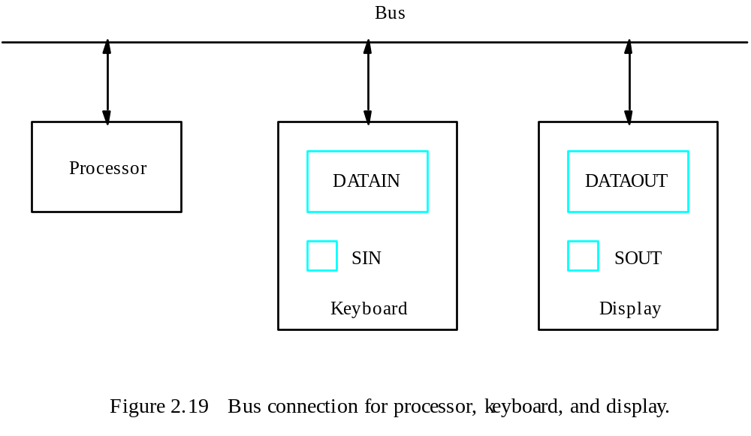
Program-Controlled I/O Example
- Registers
Flags
- Device interface

Slide 44
Program-Controlled I/O Example
Machine instructions that can check the state of the status flags and transfer data:
READWAIT Branch to READWAIT if SIN = 0
Input from DATAIN to R1
WRITEWAIT Branch to WRITEWAIT if SOUT = 0
Output from R1 to DATAOUT

Slide 45
Program-Controlled I/O Example
Memory-Mapped I/O – some memory address values are used to refer to peripheral device buffer registers. No special instructions are needed. Also use device status registers.
READWAIT Testbit #3, INSTATUS
Branch=0 READWAIT
MoveByte DATAIN, R1

Slide 46
Stacks

Slide 47
Stack Organization
DR
Current
Top of Stack
TOS
LIFO
  Last In First Out
0
1
2
3
4
5
SP
6
0 1 2 3
7
0 0 5 5
FULL
EMPTY
8
0 0 0 8
9
0 0 2 5
Stack Bottom
10
0 0 1 5
Stack

Slide 48
Stack Organization
DR
Current
Top of Stack
TOS
Current
Top of Stack
TOS
1 6 9 0
PUSH
  SP ← SP – 1
  [SP] ← DR
  If (SP = 0) then (FULL ← 1)
  EMPTY ← 0
0
1
2
3
4
5
1 6 9 0
SP
6
0 1 2 3
7
0 0 5 5
FULL
EMPTY
8
0 0 0 8
9
0 0 2 5
Stack Bottom
10
0 0 1 5
Stack

Slide 49
Stack Organization
DR
Current
Top of Stack
TOS
Current
Top of Stack
TOS
POP
  DR ← [SP]
  SP ← SP + 1
  If (SP = 11) then (EMPTY ← 1)
  FULL ← 0
0
1
2
3
4
5
1 6 9 0
1 6 9 0
SP
6
0 1 2 3
7
0 0 5 5
FULL
EMPTY
8
0 0 0 8
9
0 0 2 5
Stack Bottom
10
0 0 1 5
Stack

Slide 50
Stack Organization
Memory Stack
  PUSH
    SP ← SP – 1
    [SP] ← DR
  POP
    DR ← [SP]
    SP ← SP + 1
Memory
PC
0
1
Program
2
AR
100
101
Data
102
200
SP
201
Stack
202

Slide 51
Subroutines
Subroutine linkage method: controlling call and return from subroutine
Call instruction
  Store [PC] in link register
  Branch to target address
Return instruction
  Branch to address in link register
  PC
  Link
300
300

Slide 52
Subroutine nesting
Instead of link register, processor stack used
Any no of subroutines can be nested
Return address generated and used in last in first out order
SP: Stack Pointer- special register which points to the processor stack

Slide 53
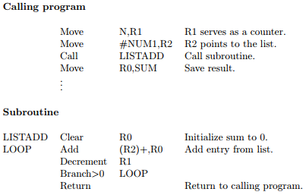
Parameter passing
Parameter passed by:
  Saving in registers/memory locations

Slide 54
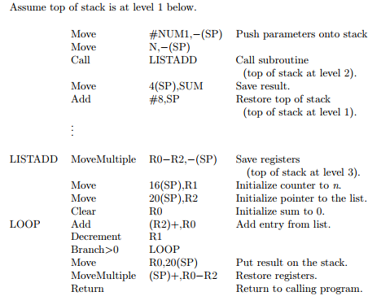
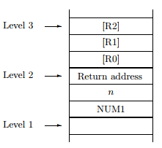
  Placing in processor stack

Slide 55
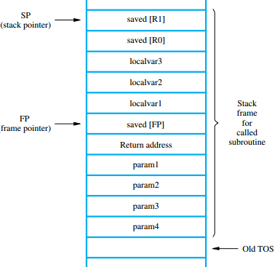
Stack frame
The location in the stack used when subroutine running, freed when subroutine ended
Frame pointer-to access parameters and local m/y variables
  Parameter: 4(FP), 8(FP)..
  Local variables: -4(FP), -8(FP)..

Slide 56
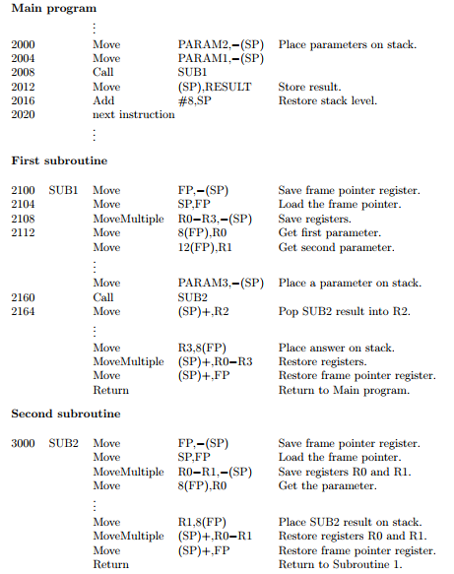
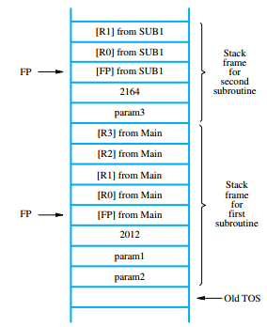


Slide 57
ARM example
Memory
  Byte addressible
  32 bit
  Register 32 bit long
  Word address aligned
  Little endian and big endian supported
  Accessed by load, store instructions

Slide 58
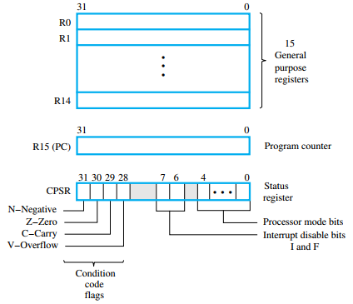
Register structure

Slide 59

Memory access Instructions
Format
Load(LDR/LDRB): operand from memory to Rd(named by 4bit)
Store(STR/STRB): operand from register to memory
Before instruction execution, condition checked
Load/store multiple operands:

Slide 60
Addressing mode
Pre indexed mode:
  EA: [base register] + offset
  Preindexed with writeback mode:
    EA written back to base register
  Post indexed:
  EA=[base register]
  Base register<- [base register]+offset
  Relative:
    EA: [PC]+ offset

Slide 61
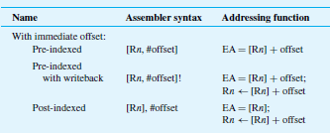
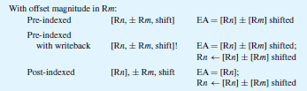
Addressing mode
  Offset can be:
    Immediate
    Stored in register

Slide 62
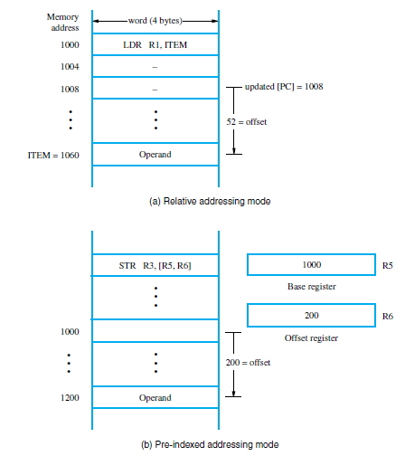
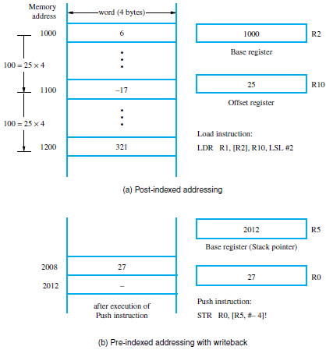

Slide 63
Register move instruction
MOV R1,R0
  R1<-[R0]
MOV R0,#76
  R0<- 76
  MVN

Slide 64
Arithmetic instructions
  Shifting and rotation operation can be incorporated
Logic instructions
  AND : AND operation
  ORR : OR
  EOR :XOR
  BIC : Bit clear

Slide 65
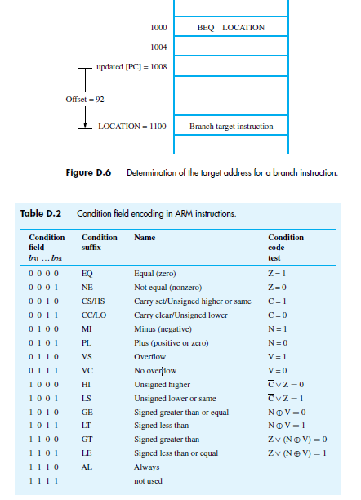
Branch instructions
<condition><op code>
<offset>

Slide 66
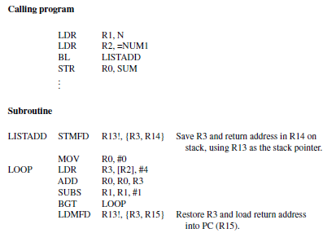
Subroutine

Slide 67
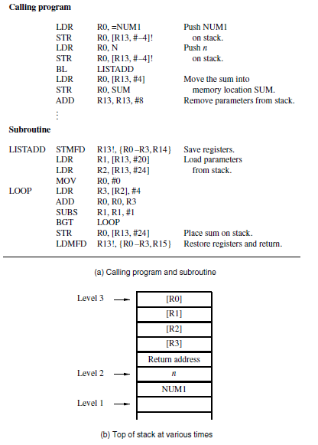

Slide 68
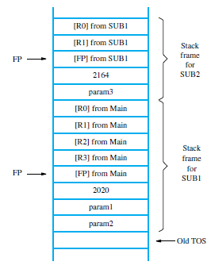
Nested subroutines

